Slide 1

Software engineering education
Learning by doing software engineering
Apprenticeship by immersion
Philippe Saliou and Vincent Ribaud
Département Informatique - Université de Bretagne Occidentale
Notes:
Good morning Ladies and Gentlemen,
I will present you how we teach and learn by doing software engineering.
My name is Vincent Ribaud and my colleague, Philippe Saliou is with me.
Unlike most other engineering fields essentially concerned with design (« design » in these fields extends from the product specifications through to the making of the initial prototype) software engineering deals with all the phases of the life of a product or a system: initial studies, manufacturing, use, maintenance, replacement.

Slide 2
Plan
  Introduction
  Immersion principles
  Donald Schön’s reflective practicum
  Some elements of the immersion system
  The Guide to the Software Engineering Body of Knowledge
  TEMPO: Thales’s corporate baseline
  Apprenticeship repository
  Linking knowledge and skills
  Shifting the immersion paradigm
  Conclusion
Notes:
The presentation is organized as follows :
First the general principles then the main components of the immersion system :
The reference framework, the environment, the apprenticeship repository and process, some words about the tutor’s role and assessment. I will finish with perspectives and a conclusion.

Slide 3
Introduction
  Immersion
    Students are immersed in a virtual software company
    The apprenticeship guideline is the project
    A reflective practicum – Donald Schön (1987)
  Environment
    ISO 9001 software processes and organization
    Model-driven engineering for n-tier Information Systems (MIS)
    Professional frameworks
  Apprenticeship process
    Apprenticeship repository
    One turn to learn, a second turn to do
    Redefinition of roles for students and teachers
    Continuous assessment
Notes:
At Brest University, students studying for a Master in Software Engineering spend two-thirds of their final year immersed in a virtual company.
[CLIC]
The main idea of the system is to simulate the real-world into university’s walls through a software project which guides all apprenticeships.
[CLIC]
The environment is as closed as possible from a software factory : a quality management system, methods and tools associated with present n-tier architecture. Each students’ team works with its own technological environment.
[CLIC]
The pedagogical system of this education program relies on an apprenticeship process integrated with the production processes in force in the industry. Two periods contribute to the learning process : a 4-months iteration to learn software engineering by doing, a 2-months iteration to put autonomously into practice the processes learned.
This approach applied to software engineering leads to revisit the education system and to redefine students’ and teachers’ roles.
The tutor’s assessment continuously sustains knowledge and skills building.

Slide 4
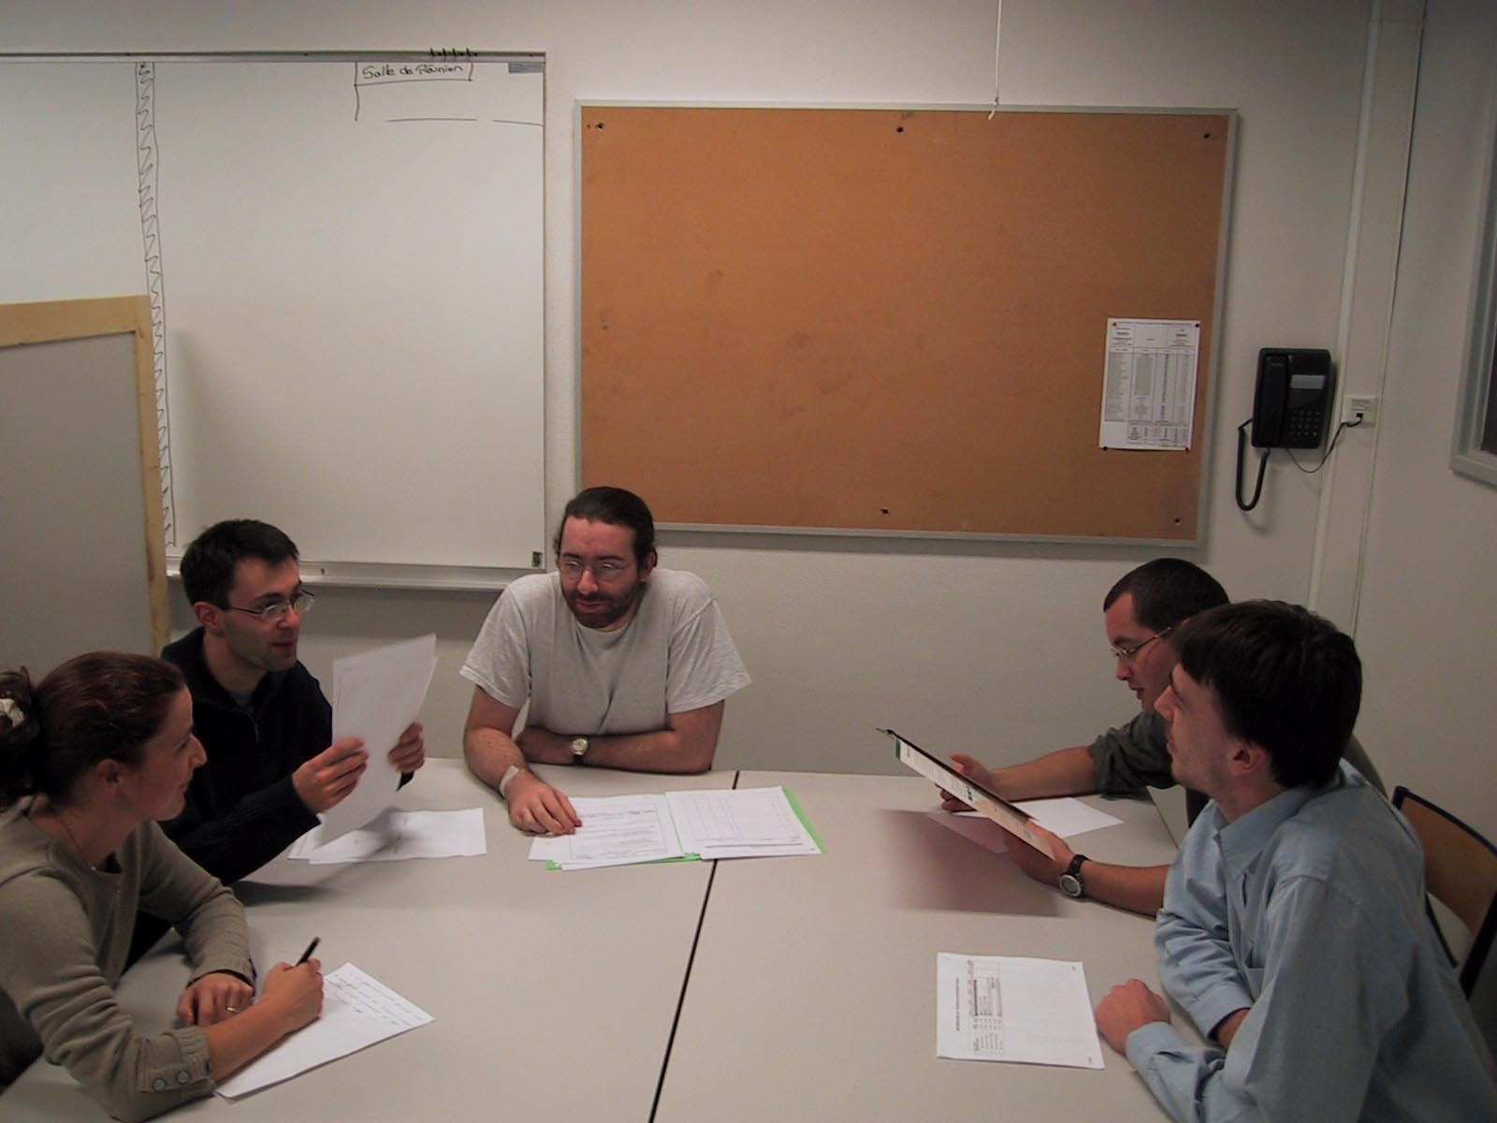
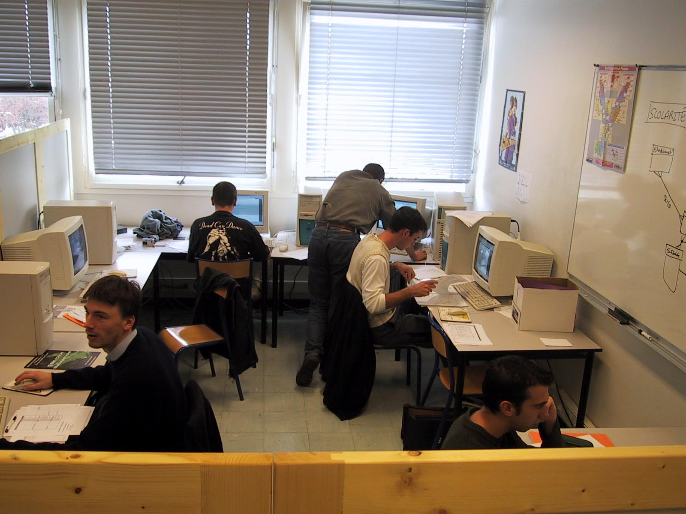
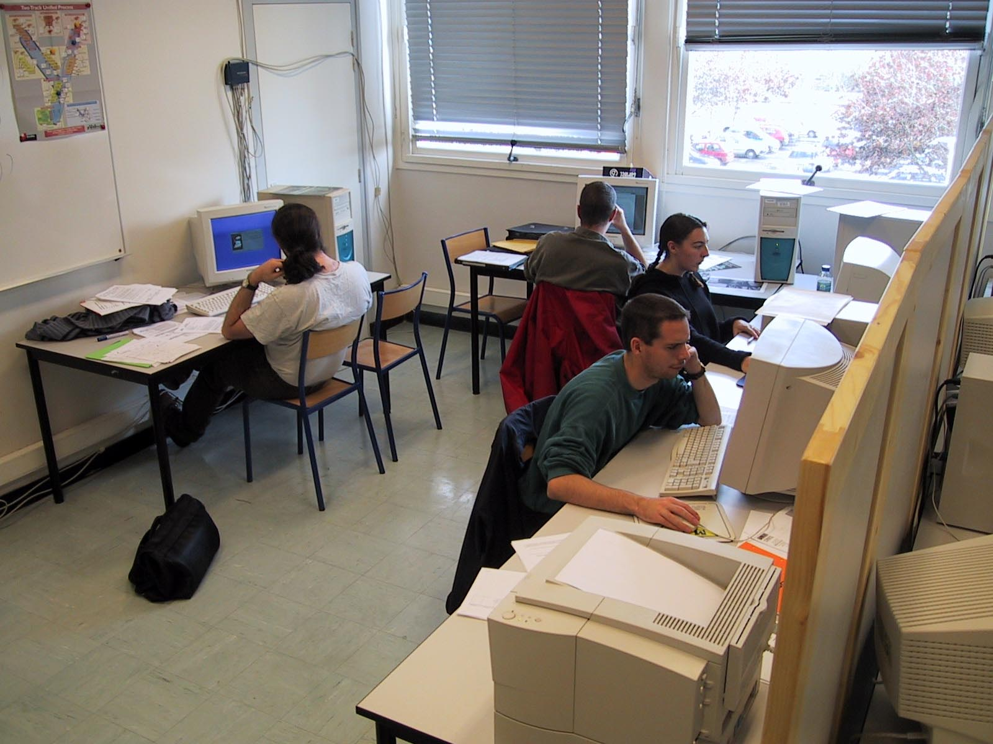
Immersion principles
Iteration 1
« Tutored apprenticeship »
Iteration 3
« Training period »
  An immersion in a realistic project
  2 companies of 6 students, led by a tutor
  A staged apprenticeship system
  Tutors’ continuous feedback and assessment
  A software development process sustained
  by a corporate baseline
  A professional technological framework
  Dedicated fitted-out rooms : landscape rooms, meeting room, machine room
4 months
4 - 6 months
Students
Iteration 2
« Accompanied application »
2 months
Meeting room
Company X
Company Y
Notes:
Let us present immersion principles.
Students do not follow any courses, excepted English and communication skills.
Teams of students are immersed in a realistic project :
the project goes on in the university tutored by a lecturer, called the company’s tutor,
the project is the global context to learn software engineering skills.
The whole apprenticeship plan of action is guided by a staged development process, under the control of Thales corporate baseline.
There is no separation between assessment and apprenticeship processes. Students are continuously building knowledge and developing skills. Tutors regularly observe what is happening in order to provide a sound feedback and to perform authentic assessment.
A different technological framework and tools set are provided to each company.
In order to emulate a standard firm environment, we fitted out laboratory rooms with a landscape room for each company, common meeting rooms and machine rooms. Each student has his/her own individual work station.
[CLIC]
The year is divided in three periods.
During the first 4-month iteration, students are swapped around the tasks dictated by engineering activities. The tutor’s help and guidance happen on a daily basis.
During the second 4-month iteration, roles are fixed within each team and the companies are relatively autonomous during the completion of the project, the tutor performing mainly a supervision and rescue activity.
Finally, the third iteration, the training period, is in fact an operational period.
The apprenticeship process is achieved in two iterations and as stated before, is guided by a staged development process. A first iteration of the process let students acquire knowledge and skills needed for each stage, the second iteration is intended to transform it into competencies.

Slide 5
Donald Schön’s reflective practicum
It’s a situation in which people learn by doing
Where they learn by doing in a practicum which is really a virtual world.
  A virtual world that represents the world of practice, but is not the world of practice.
  In that virtual world, students can run experiments cheaply and without great danger.
And they learn by doing with others in the virtual world of the practicum in interaction with someone who is in the role of coach
  more like a coach than like a teacher, because that coach is trying to help them do something.
Notes:
The immersion system relies on six essential elements:
- An organization and a breakdown of apprenticeships into three domains subdivided in activities related to the software engineering profession, and a set of apprenticeships cards providing the situated learning environment and defining tasks;
- A project immersion environment reproducing the context of a Management Information System project;
- An apprenticeship-production baseline which sustains the whole system;
- A redefinition of roles for students as well as for teachers;
- An authentic assessment process, embedded within the software engineering processes;
- A set of reflective pseudo-activities which belongs to a dimension called “continuous reflection” intended to facilitate the transformation of a student in a reflective practitioner.

Slide 6
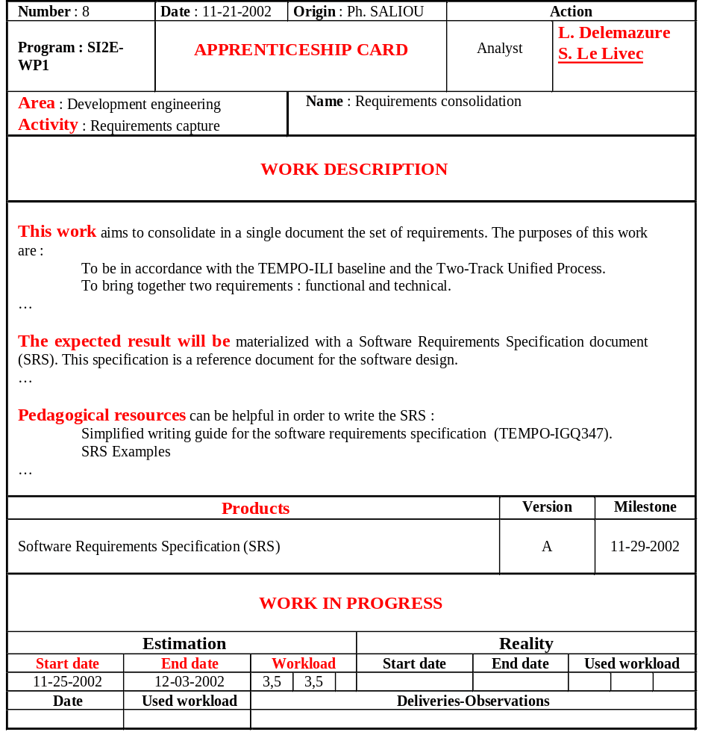

Apprenticeship process – First iteration
Area
Software project management
Software development engineering
Development support
Stages
Stage 1
Project set-up
Project set-up
Means set-up
Quality insurance setup
  Main element of the Tutor-Student relationship
  Structure
    Role(s)
    Actor(s)
    Activity type : analysis, design, ...
    Work description and pedagogical resources
    Expected deliverables
    Workload and lead-time information
Functional requirements
Functional requirements
Technical requirements
Project management
Technical support
Stage 2
Configuration management
Technical environment validation
Analysis tailoring
Requirements consolidation
Analysis
Framework exploration
Framework exploration
Methods and tools support
Stage 3
Generic design
Generic design
Technical prototype
...
Software test plan
Design tailoring
Software test plan
Notes:
The apprenticeship process is represented within a 2-dimensional array.
Columns are SE areas. The vertical axis shows the time and materializes stages and milestone scheduling.
[CLIC]
At each stage, tasks are assigned to students.
[CLIC]
For example, a subgroup works on functional requirements, another on architecture while others prepare the analysis task.
[CLIC]
The apprenticeship card describes the task. The structure is standardized, its main elements are :
the activity tied to the work,
the role to play with students’ assignment,
the work description,
the supplied pedagogical resources (here a writing guide coming from the Tempo baseline and examples),
deliverables (here a Software Requirements Specification which should comply with the standard frame),
workload and lead-time information.
[CLIC]
The whole schema is not a task planning, but only a macroscopic abstraction of students’ activities.
[CLIC]
Each student has his/her own apprenticeship process.
The slide shows in red colour the individual advance of a student during this year.

Slide 7
From apprenticeship to production – Second iteration
  Accompanied autonomy
  Real-world simulation
    Fixed organisation
    This iteration should end with the delivery of the required information system, qualified according to the validation protocol written by the project team
  The apprenticeship process becomes a development process
  Progress
    The company’s tutor stands back
    Apprenticeship Card (AC) -> Manufacturing Card (MC)
    The student acting as project manager chairs progress report meetings
Notes:
At the end of the first iteration, students carried out different engineering activities and used deliverables produced by other students during previous stages.
[CLIC]
A fixed organization of the team is set up for the second iteration. The whole team has to deliver a full product validated according a V&V protocol written by the students themselves.
[CLIC]
Students will rely on the apprenticeship process and apprenticeship cards of the first iteration but the company is shifting towards a development process.
The company’s tutor stands back in order to allow the company to stand on one’s own two feet.
Apprenticeship cards help to elaborate Manufacturing Cards. The weekly progress meeting is now chaired by the student-project manager.
[CLIC]
This iteration is also an opportunity to develop some engineering activities.
, but the company’s tutor is still supporting the student acting as a project manager.

Slide 8
Authentic assessment
Regulation assessment
Verification and validation assessment
Regulation assessment
  Tutor-Author cycle
    Carefully examination of deliverables
    Feedback
    Reworking
  Apprenticeship supervision and regulation
    Writing, planning and assigning Apprenticeship Cards
    Bi-weekly regulation meeting
Verification and validation assessment
  Validation and reviews
    Contribute to the important role play
    Still a formative experience
Notes:
Our immersion system defines two kinds of authentic assessment :
regulation assessment is a direct support to knowledge building by providing continuous feedback
V &V assessment ensures specific minimum verification and validation tasks and their required inputs and outputs
Let us detail a little.
[CLIC] [CLIC]
During the Tutor-Author cycle
Each deliverable is carefully examined by the tutor who :
Annotates, corrects, make proposals, reorientates
Writes an assessment card including all the points to improve or to start over
The feedback is given in front of the team mate
2 Assessment cycles are generally necessary in order to guarantee a satisfactory result, sufficient to carry on the project.
[CLIC]
Apprenticeship supervision and regulation are a main task.
Recall that the whole software development cycle is accomplished at each iteration.
Writing, planning and assigning Apprenticeship Cards is a heavy and fundamental activity to manage apprenticeships.
[CLIC]
Verification and validation assessment is inspired from V &V activities of the software industry
It contributes to the important role play which is a part of the immersion :
It simulates control milestones.
The experience is also formative with feedback being given during and after the assessment
It’s a transition towards professional procedures of assessment.

Slide 9
The SWEBOK
The Guide to the Software Engineering Body of Knowledge (SWEBOK) was established with five objectives:
  To promote a consistent view of software engineering worldwide
  To clarify the place—and set the boundary—of SE with respect to other disciplines such as computer science, ...
  To characterize the contents of the SE discipline
  To provide a topical access to the SE Body of Knowledge
  To provide a foundation for curriculum development and for individual certification and licensing material
Notes:
The first of these objectives, a consistent worldwide view of software engineering, was supported by a development process which engaged approximately 500 reviewers from 42 countries in the Stoneman phase (1998–2001) leading to the Trial version, and over 120 reviewers from 21 countries in the Ironman phase (2003) leading to the 2004 version.

Slide 10
The SWEBOK Knowledge Areas (KAs)
Software requirements
Software design
Software construction
Software testing
Software maintenance
Software configuration management
Software engineering management
Software engineering process
Software engineering tools and methods
Software quality
Notes:
The second of the objectives, the desire to set a boundary for software engineering, motivates the fundamental organization of the Guide. The material that is recognized as being within this discipline is organized into the first ten Knowledge Areas (KAs) listed in this slide. Each of these KAs is treated as a chapter in this Guide.

Slide 11
Third objective—a characterization of the contents of SE
The Guide uses a hierarchical organization to decompose each KA into a set of topics.
The Guide treats the selected topics in a manner compatible with breakdowns generally found in industry and in SE literature and standards.
Each topic only describes the generally accepted nature of the topic and helps to find reference material.
After all, the Body of Knowledge is found in the reference material themselves, not in the Guide.
Notes:
The organization of the KA descriptions or chapters supports the third of the project’s objectives—a characterization of the contents of software engineering.
The Guide uses a hierarchical organization to decompose each KA into a set of topics with recognizable labels. A two- or three-level breakdown provides a reasonable way to find topics of interest. The Guide treats the selected topics in a manner compatible with major schools of thought and with breakdowns generally found in industry and in software engineering literature and standards. The breakdowns of topics do not presume particular application domains, business uses, management philosophies, development methods, and so forth.
The extent of each topic’s description is only that needed to understand the generally accepted nature of the topics and for the reader to successfully find reference material. After all, the Body of Knowledge is found in the reference material themselves, not in the Guide.

Slide 12
TEMPO: Thales’s corporate baseline
The company’s “corporate baseline”, TEMPO
  a vital tool for demonstrating the ability of its quality system to meet general requirements (such as ISO).
TEMPO is the foundation of corporate culture and is the basis for sustaining good working practices.
TEMPO is a set of procedures, guides and instructions :
  defining how the company operates and how it is organised,
  providing a framework for programme management, software development and system integration activities.

Slide 13
Apprenticeship by immersion repository
Apprenticeship repository
TEMPO-ILI
Technical frameworks support
Technical libraries and forum
Books and self-training media
Apprenticeship process description
  Role play
  Development cycle
  Stages
  Work cards
    Pedagogical resources
    Expected deliverables
  Previous deliverables
Manufacturing processes
Company X
Company Y
MVC Framework for J2EE
JSP
MVC Framework for J2EE
Java
Entity Bean
Java RMI
Entity Bean
Java RMI
Servlet
J2EE
Oracle
J2EE
Oracle
Oracle9i Database
Oracle9i Database
EJB
JDeveloper
EJB
JDeveloper
Session Bean
Designer
Session Bean
Designer
UML
UML
WebSphere
WebSphere
Building
Reports
Reports
SCM
SCM
IBM
IBM
Rational Entreprise
Rational Entreprise
DB2
XML
DB2
XML
RationalRequisitePro
RationalRequisitePro
HTTP
Rational Entreprise
HTTP
TopLink
Rational Entreprise
TopLink
XDE
XDE
ClearCase
ClearCase
HTML
HTML
BC4J
BC4J
WebSphere Application Server
JHeadStart
WebSphere Application Server
JHeadStart
Oracle 9iAS
Oracle 9iAS
JDBC
JDBC
Corporate baseline
ISO 9001
Notes:
We created a first version of the repository five years ago. Since then, we have continuously updating what constitutes both an apprenticeship repository of the software engineering profession and a production baseline of deliverables. The main parts are :
we tailored TEMPO in a TEMPO-ILI baseline enriched with real examples and other references;
we added also use supports for technical framework, books and self-training media; most resources being provided through an academic contract with editors
The heart of the apprenticeship process description is described mainly with
- a staged and iterative learning process,
- work cards defining, stage by stage, required knowledge and skills together tasks to be done,
- the important role play which happens during the stages,
- some carefully chosen deliverables issued from previous years

Slide 14
Linking knowledge and skills
Diploma supplement → establish two lists per unit :
  one for the knowledge covered in the unit,
  the other for the abilities linked to the unit.
The abilities (competencies) list : description of activities and tasks from
  the corporate baseline
  the work cards of the immersion system
  The knowledge list :
  more difficult to extract the knowledge really covered
  even with the help of the SWEBOK
For others curricula, it may be the other way round
Notes:
There is a strong relationship between Knowledge Areas and topics of the SWEBOK and activities of a corporate software engineering baseline. An interesting issue arises when we worked to establish the diploma supplement for our immersion curriculum. For each unit of the curriculum, we were required to establish two lists: one for the knowledge covered in the unit and the other for the abilities linked to the unit. We established easily the abilities list from the description of activities and tasks found in the corporate baseline and in the work cards of the curriculum. It was more difficult by far to extract the knowledge really covered by the unit, even with the help of the SWEBOK.
Let us present an example with the “Quality Assurance (QA)” unit. During this activity, students perform quality assurance control established in the QA plan, mainly technical reviews and product inspections. Such are the abilities of the QA unit.
Let us have a look on the SWEBOK guide about the KA “Software quality”. This KA is divided in 11 subtopics, including the “Reviews and Audits” subtopic.
Practically, students learn this subtopic and only this subtopic by doing, but through performing this review activity there are linked to several other subtopics of the KA.
For others curricula, it may be the contrary. For each unit (which corresponds generally to a subtopic of the domain), the knowledge list is easier to establish than the competencies list.

Slide 15
Unification reference framework
Software engineering
Apprenticeship
by immersion
SPM
SDE
SDS
Software project management
Software development engineering
Software development support
PM
TS
RC
TA
Project management
Technical support
Requirements capture
Technical requirements
University
Professional branch
MTS
SA
AQ
Methods and tools support
Software analysis
SD
Quality Insurance
Software design
UD
CUT
SCM
User’s documentation
Coding – Unit testing
Software configuration management
IV
Integration - Validation
Pedagogical team
Students
ID
Installation - Deployment
Notes:
There is a need for a reference framework between all actors.
[CLIC]
Our reference framework relies on software engineering activities organized around three main areas : project management, development engineering and support.
From the professional branch point of view, figure 1 is a breaking down of the software engineering profession focused on three areas (engineers’ specialization) subdivided in various activities. From the university point of view, this division is the reference framework in a diploma-awarding perspective. For the pedagogical team and students, this taxonomy is the reference nomenclature of apprenticeships.
From the classic university’s point of view, SE activities represent the course units and they support formal assessment; from the others’ point of view, SE activities are competencies to develop and main areas are specialization of a software engineer.

Slide 16
Shifting the immersion paradigm
Duffy and Cunningham, Constructivism :
  learning is defined as an active process for knowledge building rather than a knowledge acquisition process
  teaching is essentially aimed at helping students in this process rather than transmitting knowledge
At the organizational level, the shift involves at least two dimensions.
  First, lectures are replaced with student learning.
  Secondly, the whole immersion system should operate as a learning organization.
The main goal of the system is to educate skilled but also reflective practitioners
Notes:
At the individual level, shifting to the immersion paradigm means a new way of thinking for tutors and students. The immersion system belongs to the constructivism approach.
At the organizational level, the shift involves at least two dimensions.
In the first dimension, “teachers” perfom three different kinds of activities: - Organising - It is a matter of scheduling and elaborating work cards that define, week after week, the work to be done and preparing pedagogical deliveries needed to carry out the work; - Tutoring - For each work card, a tutor is available to students who are thus provided with continuous support and assistance; - Continuous assessment - Each deliverable is carefully annotated by tutors, together with improvements to bring about. This assessment and feedback process is iterated at least twice.
In the second dimension, our system re-unifies the place, the time and the means of apprenticeships thanks to the immersion in a realistic (but not real) project. Learning is cooperative, collaborative and supportive. Assessment emphasises on generating questions and learning from errors.

Slide 17
Conclusion
  Last year of a Master in Computer Engineering
    A new kind of learning, but also a new kind of teaching
    Strong commitment is required
  Pros
    Immersion in a real project
    Working in a team
    Complex technological frameworks
    Model-driven development
    Apprenticeship repository of the software engineering
  Cons
    A fragile system : everybody has to play the roles
    Heavy assessment
Notes:
As a first conclusion, the important point is to learn competencies and work knowledge and to use them concretely. This approach applied to software engineering leads to revising the education system.
Our immersion system is exciting and innovative and achieves most of pedagogical objectives.
Students use a a model-driven engineering process to build a N-tier information system with complex technological frameworks.
They gain an experience of one year in a software team.
Each year, we are capitalizing our experiments into our apprenticeship repository.
On the other hand the system is fragile if either teachers or students are unable to play the roles required.
Continuous assessment is sometimes too heavy.

Slide 18
More details

Slide 19
Immersion environment
  Pedagogical objectives
  Model-driven engineering
  N-tier information systems
  Complexity of infrastructures
  Market frameworks and tools
  2-Track Unified Process
  ISO 9001 corporate baseline
ISO 9001
  Each company uses a different framework
Company X
Company Y
Servlet
Java
JSP
Oracle
Designer
Oracle10g database
J2EE
Session Bean
JDeveloper
WebSphere
EJB
ADF
UML
DB2
SCM
IBM
Rational Architect
Business Components
EJB
ClearCase
Rational RequisitePro
UIX
Beans
Web Services
JHeadStart
OAS 10g
XML
TopLink
WebSphere Application Server
Java RMI
HTML
MVC Framework for J2EE
HTTP
Notes:
We designed the environment with several pedagogical objectives in mind :
[CLIC]
Model-driven engineering
N-tier information systems
Complexity of infrastructures
Market framework and tools
The main goal is the complexity as a matter of priority. Complexity compels students to abstract and to use case tools, as well as complex frameworks for development support.
That is while we built our immersion environment around 3 pillars.
[CLIC]
The development process we kept is the 2-Track Unified Process.
The truly specific features of a unified process are as follows :
use case driven, architecture-centered, iterative and incremental.
[CLIC]
Tempo is the corporate baseline of Thales Information System. We are restricted to using just one part of Tempo and for pedagogical purposes only.
[CLIC]
Of course, the technical framework of a master should use tools and languages expected by the market. Each company uses a different framework : Oracle and Open Source or IBM and Rational.
2-Track means that the process follows both a functional path and a technical architecture path.
The outcome of the 2 tracks leads to merge the 2 ways results, so that the system is built.

Slide 20
Tutors’ and students’ roles
  « Coordinator »
    prepares the logistics, consolidates and tailors the apprenticeship repository, supervises the pedagogical system.
  « Company’s tutor »
    defines the new project, leads the student’s team, coordinates and regulates students’ apprenticeships (individual and collective).
  « A builder »
    In turn architect, project manager, manufacturer, inventor, artist.
    Provides / uses pieces of the puzzle, understands long-term issues, works regularly.
  « An explorer »
    Sometimes there is no pre-defined way.
    Has to discover new skills, to invent personal solutions.
  « A team member »
    Be aware that nothing can be done without others.
    Cooperates truly rather negotiating mutual services.
  « A citizen »
Notes:
There are two main functions in our immersion system: coordinator which is supervising the system and company’s tutor.
The “Coordinator” is working all the year long. He/she has to:
- prepare the logistics necessary for the smooth running of the service : to make an inventory of company’s resources and to sort them out, to forecast needs in hardware of software, to negotiate contracts with software providers, to supply with and receipt new resources.
- consolidate and to tailor the apprenticeship repository in order to make it easier to use by the tutors and the students.
- supervise the pedagogical system in order to fulfil the requirements of an academic institution : scheduling, grading, relationships with stakeholders, etc.
The “Company’s tutor” is working during the two first iterations. He/she has to:
- define the new project in which the students will be immersed. He/she has to write requirements, then a response to solicitation including a technical and commercial offer answering the expected needs.
- lead the student’s team. He/she is the authentic software manager inside the company, coordinates students’ work and adjusts the planning according to real work progress.
- coordinate and to regulate students’ apprenticeships (individual and collective). He/she assists students on a daily basis. He/she annotates and corrects deliverables, makes proposals, reorientates and finally assesses deliverables.
The first role is called “a citizen”. Each student lives with their team mates during 6 months, 5 days a week, 8 hours a day. The respect of others, of their work, of their own working place and of the common infrastructure is fundamental when working in a team. Unlike what happened during previous years, the student must realize that the respect for the environment and a few rules (working hours, computer security, deadlines) is not enforced by the institution but accepted by each student.
The main role is called “a builder”. The student is in turn architect, project manager, manufacturer, inventor, and artist. Sometimes he/she will be providing others with products or services; sometimes he/she will be using the other students’ work. He/she must understand that his/her own work takes place within a structured set and that the success of each piece is necessary to the success of the whole project itself. The understanding of long term issues should always be kept in mind and regular and sustained efforts are essential. It breaks away from previous attitudes where efforts are mainly motivated by the examination deadlines.
Beside this building activity, the apprentice engineer must sometimes transform him/herself into “an explorer”. Students cannot always find their way in the maze of pedagogical resources provided (manuals, tutorials, white papers) or in the explanations that they can get from tutors. So there is nothing to help them through the work they have to do. The student generally feels very uncomfortable and this situation is aimed at pushing him/her to deepen existing knowledge, to discover new skills, to invent personal solutions.
Each of these three previous roles bring us back to the question of teamwork and hence to the definition of the role “a team member”. Students, until now engaged in a rather individualistic learning process (although they are used to negotiating mutual services) must be aware of the fact that nothing can be done without others or more exactly, that they need the others to do everything. It is not possible to describe the attitudes that each team member will have, develop or discover in others.

Slide 21
Characteristics of authentic assessment
Embedding assessment into apprenticeships
The assessment of complex tasks is replaced by the continuous assessment of activities and deliverables.
Two kind of assessment :
  Direct support to the knowldege building with a continuous feedback to learners, called regulation assessment (De Ketele)
  Verification and validation (V & V) activities
Notes:
The pedagogical stream of immersion advocates an authentic assessment, mainly
1. Assessments tasks should be meaningful, worth mastering.
2. The set of tasks should be a valid sample from which generalizations about overall performance can be made.
3. Scoring should include points awarded or taken away for essential successes and errors.
4. The performance standards that anchor the scoring should be authentic benchmarks.
5. The context of the problems should be rich, realistic, and enticing.
6. The tasks should be validated.
7. The scoring should be feasible and reliable.
8. Results should be reported and used.
[CLIC]
Our immersion system defines two kinds of authentic assessment :
regulation assessment directly supports knowledge building by providing continuous feedback
V &V assessment ensures specific minimum verification and validation tasks and their required inputs and outputs

Slide 22
An example - The Software Quality KA
The Software Quality KA transcends the software life cycle processes
  it is also considered in many of the other KAs
The description of this KA covers three subareas :
  Software Quality Fundamentals (4 subtopics)
    software engineering culture and ethics, the value and costs of quality, models and quality characteristics, and quality improvement.
  Software Quality Management Processes (3 subtopics)
    software quality assurance, verification and validation, reviews and audits
  Practical Considerations (4 subtopics)
    software quality requirements, defect characterization, software quality management techniques, and software quality measurement
Notes:
The Software Quality KA deals with software quality considerations which transcend the software life cycle processes. Since software quality is a ubiquitous concern in
software engineering, it is also considered in many of the other KAs, and the reader will notice pointers to those KAs throughout this KA. The description of this KA covers three
subareas.
The first subarea describes the Software Quality Fundamentals such as software engineering culture and ethics, the value and costs of quality, models and quality characteristics, and quality improvement.
The second subarea covers Software Quality Management Processes. The topics here are software quality assurance, verification and validation, and reviews and audits.
The third and final subarea describes Practical Considerations related to software quality. The topics are software quality requirements, defect characterization, software quality
management techniques, and software quality measurement.

